Slide 1
Data & Sampling Distribution
Unit 02 Lecture 04
Dr Muhammad Ismail Mangrio

Slide 2
Contents
Random Sampling and Sample Bias
  Bias
  Random Selection
  Size Versus Quality: When Does Size Matter?
  Sample Mean Versus Population Mean
Selection Bias
  Regression to the Mean
Sampling Distribution of a Statistic
  Central Limit Theorem
  Standard Error
The Bootstrap
  Resampling Versus Bootstrapping
Confidence Intervals
Normal Distribution
  Standard Normal and QQ-Plots
Long-Tailed Distributions
Student’s t-Distribution
Binomial Distribution
Chi-Square Distribution
F-Distribution
Poisson and Related Distributions
  Poisson Distributions
  Exponential Distribution
  Estimating the Failure Rate
  Weibull Distribution

Slide 3
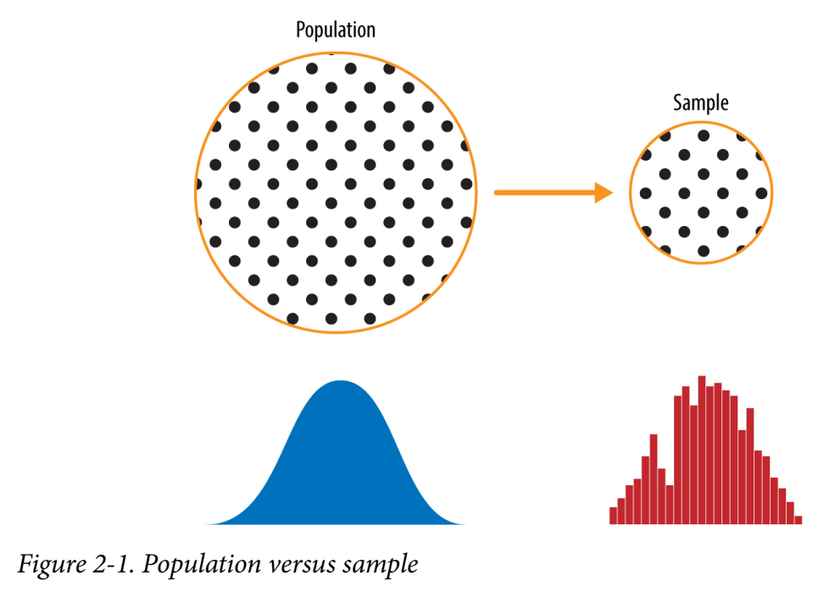
Population and Samples
Population: Everything in the group that we want to learn about.
Sample: A part of the population.
For good statistical analysis, the sample needs to be as "similar" as possible to the population. If they are similar enough, we say that the sample is representative of the population.
The sample is used to make conclusions about the whole population. If the sample is not similar enough to the whole population, the conclusions could be useless.
Population | Sample
All of the people in Germany | 500 Germans
All of the customers of Netflix | 300 Netflix customers
Every car manufacturer | Tesla, Toyota, BMW, Ford

Slide 4
Data and sampling distributions
The lefthand side represents a population that, in statistics, is assumed to follow an underlying/core but unknown distribution.
All that is available is the sample data and its empirical/observed distribution, shown on the righthand side.
Aa sampling procedure is used to get sample from population.
Traditional statistics focused very much on the population, using theory based on strong assumptions about the population.
Modern statistics has moved to the sampling, where such assumptions are not needed.
In general, data scientists need not worry about the theoretical nature of the population but focus on the sampling procedures.
  Like in any real-life binomial situation (buy or don’t buy, fraud or no fraud, click or don’t click) can be modeled effectively by a coin with modified probability of landing.
In these cases, we can gain additional insight by using our understanding of the population

Slide 5
Random Sampling and Sample Bias
Random sampling is a process in which each available member of the population being sampled has an equal chance of being chosen for the sample at each draw.
The sample that results is called a simple random sample.
  Sampling can be done with replacement, in which observations are put back in the population after each draw for possible future reselection.
  Or it can be done without replacement, in which case observations, once selected, are unavailable for future draws.
Data quality often matters more than data quantity when making an estimate or a model based on a sample.
  Data quality in data science involves completeness, consistency of format, cleanliness, and accuracy of individual data points.
Example of sampling: Literacy Digest poll of 1936 used 10 million people to predict victory of Alf Landon over Franklin Roosevelt. George Gallup just used sample of 2000 people and made prediction for Franklin.

Slide 6
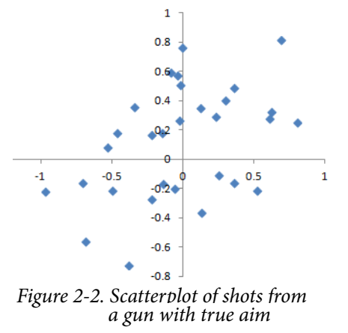
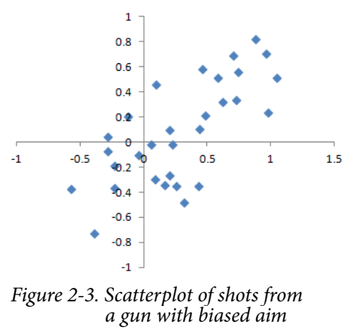
Bias
Statistical bias refers to measurement or sampling errors that are systematic and produced by the measurement or sampling process.
Consider the physical process of a gun shooting at a target.
  It will not hit the absolute center of the target every time, or even much at all.
  An unbiased process will produce error, but it is random and does not tend strongly in any direction (see Figure 2-2).
  The results shown in Figure 2-3 show a biased process—there is still random error in both the x and y direction, but there is also a bias.
  Shots tend to fall in the upper-right quadrant.
Bias comes in different forms, and may be observable or invisible.
When a result does suggest bias (e.g., by reference to a benchmark or actual values), it is often an indicator that a statistical or machine learning model has been mis-specified, or an important variable left out.
An important distinction should be made between errors due to random chance and errors due to bias.

Slide 7
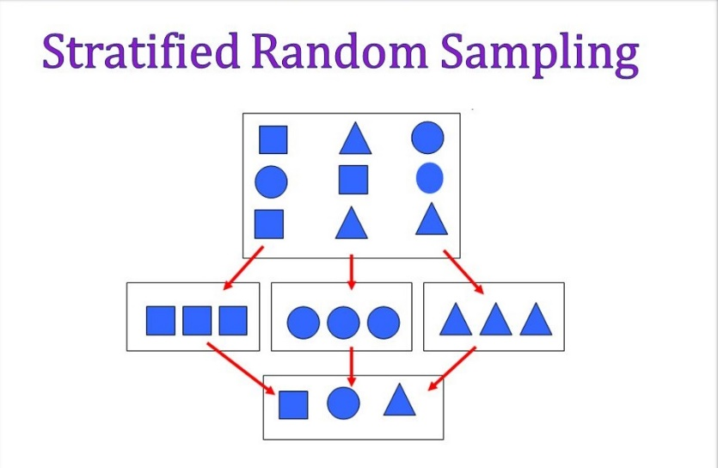
Random Selection
To avoid the problem of sample bias a variety of methods to achieve representativeness, but at the heart of all of them lies random sampling.
In stratified sampling, the population is divided up into strata (smaller sub-groups), and random samples are taken from each stratum.
Political researchers might seek to learn the electoral preferences of whites, blacks, and Hispanics (Spanish Americans).
A simple random sample taken from the population would yield too few blacks and Hispanics,
so those strata could be over-weighted in stratified sampling to yield equivalent sample sizes.

Slide 8
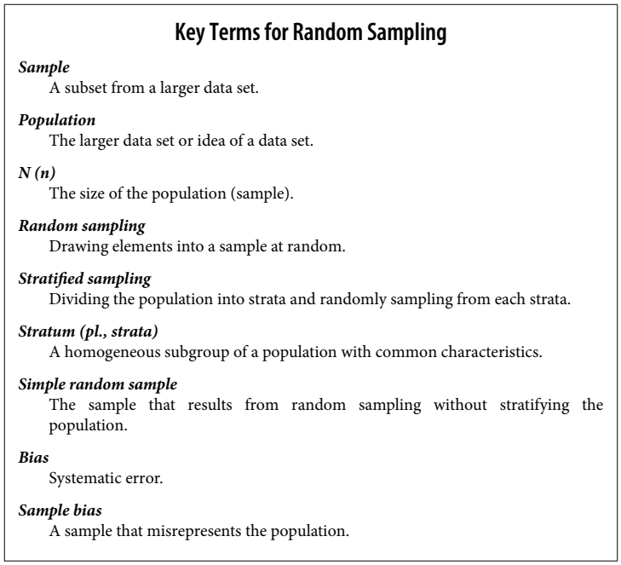

Slide 9
Size Versus Quality: When Does Size Matter?
In the era of big data, it is sometimes surprising that smaller is better.
Time and effort spent on random sampling not only reduces bias but also allows greater attention to data exploration and data quality.
For example, missing data and outliers may contain useful information.
It might be too expensive to track down missing values or evaluate outliers in millions of records, but doing so in a sample of several thousand records may be feasible.
Data plotting and manual inspection bog down if there is too much data.

Slide 10
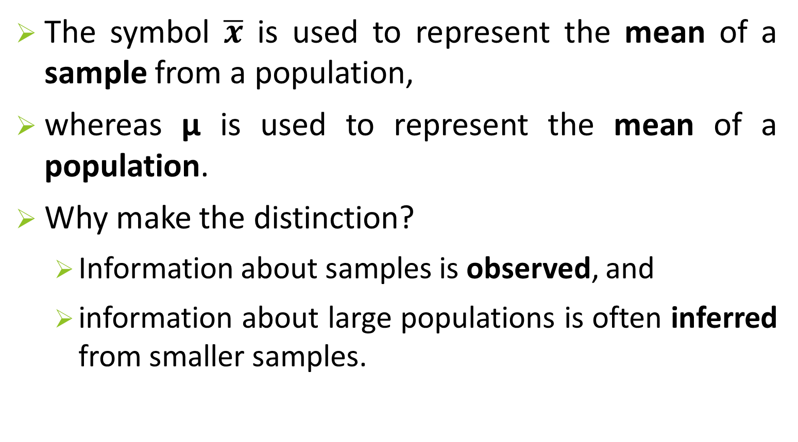
Sample Mean Versus Population Mean
The symbol $\overline{x}$ is used to represent the mean of a sample from a population,
whereas μ is used to represent the mean of a population.
Why make the distinction?
  Information about samples is observed, and
  information about large populations is often inferred from smaller samples.

Slide 11
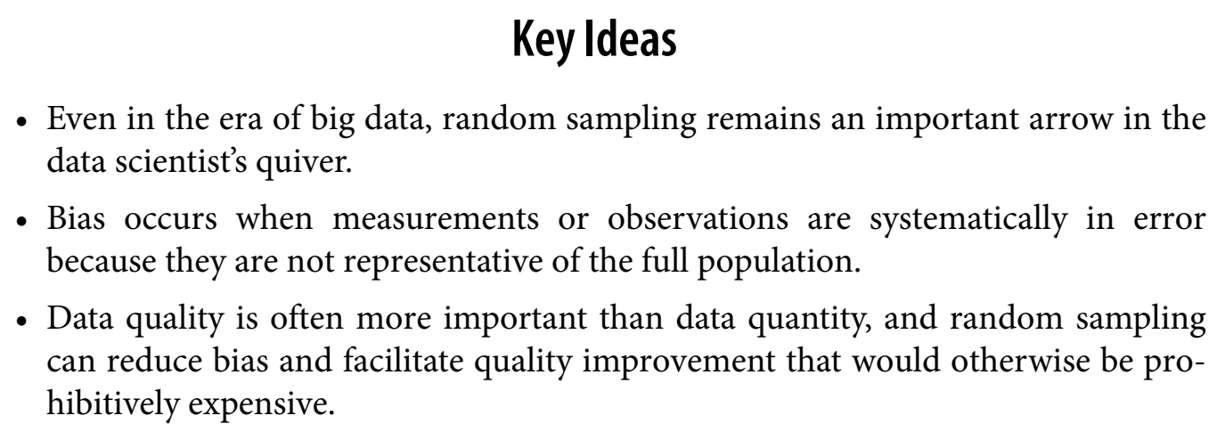
Key ideas

Slide 12
Selection Bias
Selection bias refers to the practice of selectively choosing data consciously or unconsciously in a way that leads to a conclusion that is misleading or ephemeral/temporary.
Selection bias is the bias introduced by the selection of individuals, groups, or data for analysis in such a way that proper randomization is not achieved, thereby failing to ensure that the sample obtained is representative of the population intended to be analyzed.
Data snooping
  If you specify a hypothesis and conduct a well-designed experiment to test it, you can have high confidence in the conclusion. This is frequently not what occurs, however. Often, one looks at available data and tries to perceive patterns.
    But are the patterns real? Or
    are they just the product of data snooping (that is, extensive hunting through the data until something interesting emerges)?
  There is a saying among statisticians: “If you torture the data long enough, sooner or later it will confess/admit.”

Slide 13
Selection Bias (optional reading)
Selection bias is a sort of bias that develops when the population of interest is not adequately represented in the sample of people or observations being researched.
Selection bias can alter the generalizability of the findings and result in erroneous or misleading estimations of demographic characteristics.
For instance, if research only includes individuals who satisfy specific requirements, the findings could not apply to the entire community. It can also happen if a sample contains groups that are either overrepresented or underrepresented, which might result in findings that are not representative of the population as a whole.

Slide 14
Selection Bias: Example: Luck or talent
Imagine that someone tells you they can flip a coin and have it land heads on the next 10 tosses.
  You challenge them (the equivalent of an experiment), and they proceed to toss the coin 10 times, with all flips landing heads.
  Clearly you ascribe some special talent to this person—the probability that 10 coin tosses will land heads just by chance is 1 in 1,000.
Now imagine that the announcer at a sports stadium asks the 20,000 people in attendance each to toss a coin 10 times, and to report to an attendant if they get 10 heads in a row.
  The chance that somebody in the stadium will get 10 heads is extremely high (more than 99%—it’s 1 minus the probability that nobody gets 10 heads).

Slide 15
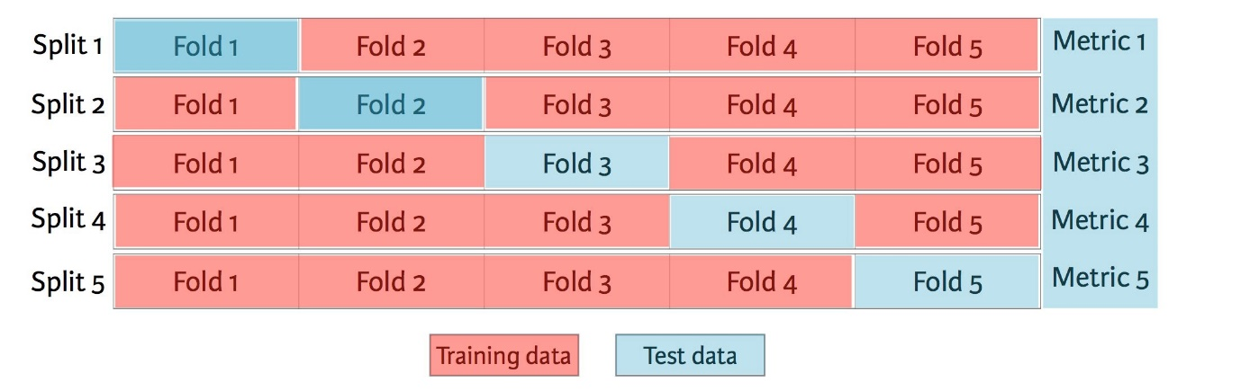
Selection Bias
Since repeated review of large data sets is a key value proposition in data science, selection bias is something to worry about.
A form of selection bias of particular concern to data scientists is what John Elder (founder of Elder Research, a respected data mining consultancy) calls the vast search effect.
Vast search effect:
  If you repeatedly run different models and ask different questions with a large data set, you are bound to find something interesting.
  But is the result you found truly something interesting, or is it the chance outlier?
We can guard against this by using a holdout set, and sometimes more than one holdout set, against which to validate performance.
Typical forms of selection bias in statistics, in addition to the vast search effect, include nonrandom sampling

Slide 16
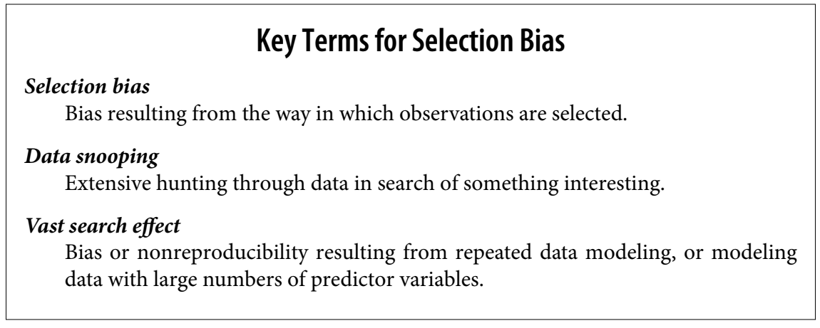
Selection Bias

Slide 17
Regression to the Mean
Regression to the mean refers to a phenomenon involving successive measurements on a given variable: extreme observations tend to be followed by more central ones.
Regression to the mean (RTM) is a statistical phenomenon describing how variables much higher or lower than the mean are often much closer to the mean when measured a second time.
Attaching special focus and meaning to the extreme value can lead to a form of selection bias.
The phenomenon was first identified by Francis Galton in 1886 [Galton-1886], who wrote of it in connection with genetic tendencies;
  for example, the children of extremely tall men tend not to be as tall as their father

Slide 18
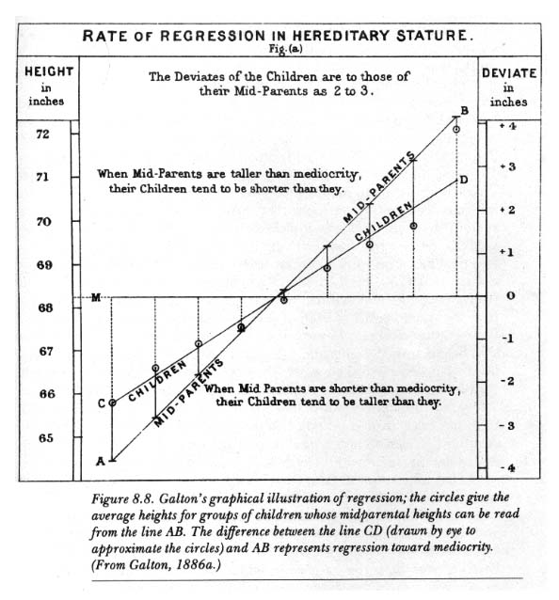
Regression to the Mean
In more recent studies RTM has been reported in birth weights, blood pressure, and cholesterol. Nevertheless it continues to be missed by some public health researchers; for example, part of the 90% drop in cases of meningitis C in the UK after the introduction of an immunization programme could be due to a very bad year being likely to be followed by a better year.
Players or teams featured on the cover of SI have earned their place by performing exceptionally well. But athletic success is a mix of skill and luck, and even the best players don’t always win.
Chances are that good luck will not continue indefinitely, and neither can exceptional success.

Slide 19
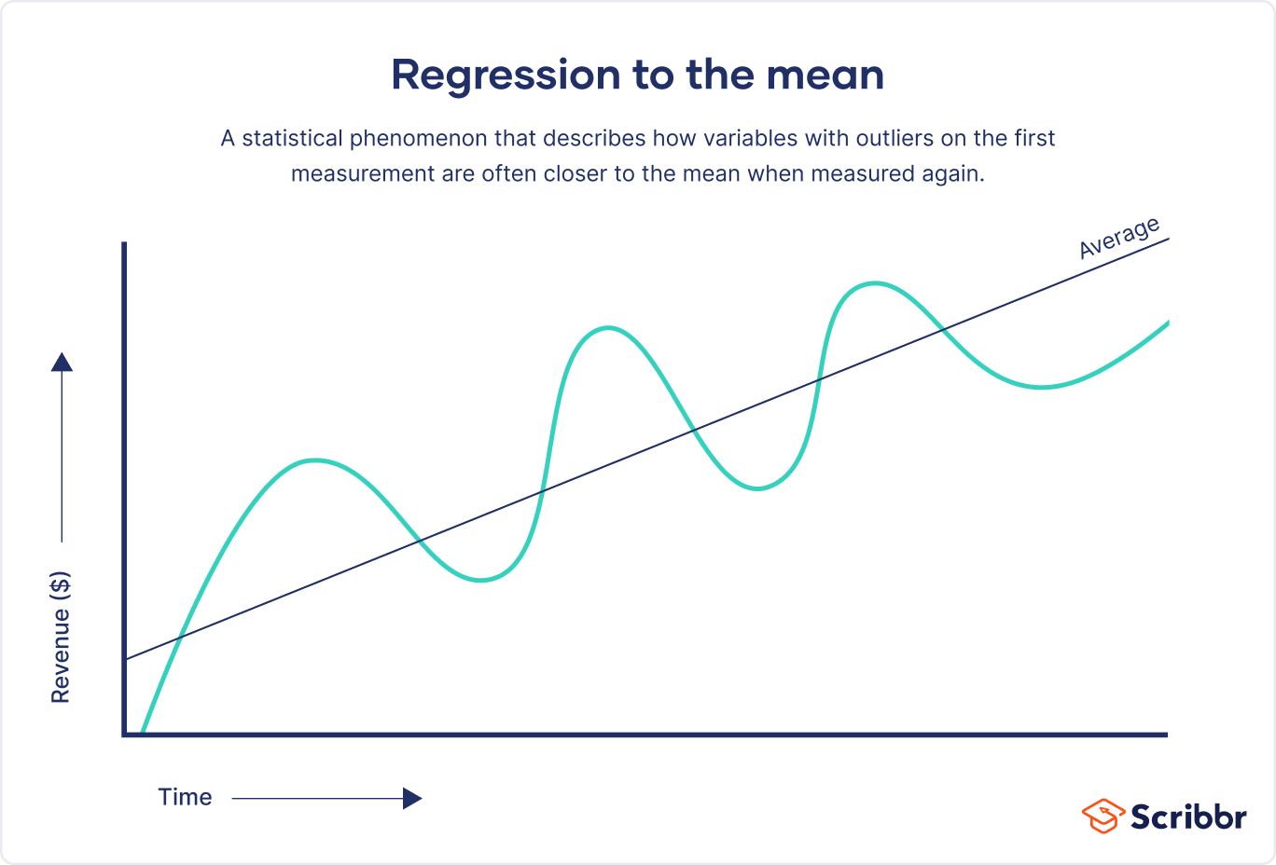
Regression to the Mean
Regression to the mean can prove problematic particularly in research studies that measure the effectiveness of an intervention, program, or policy.
It can mislead researchers to believe that an intervention is the cause of an observed change, when in reality it is due to chance.
This is particularly evident when researchers focus on measurements of people, cases, or organizations at the extremes, such as the worst-performing, the best-educated, or the unhealthiest.
RTM shows us that, statistically, the lowest cases are likely to improve the second time, while those at their peak will likely perform worse even without the intervention. Because it can distort results, you need to take regression to the mean into account when designing your research as well as when analysing your findings.

Slide 20
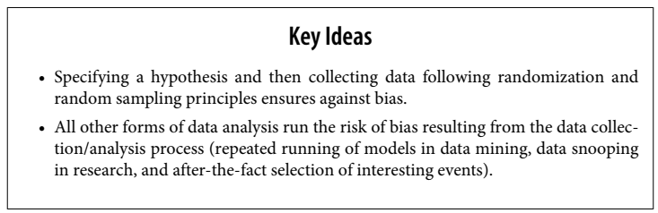

Slide 21
Sampling Distribution of a Statistic/Fact
The term sampling distribution of a statistic refers to the distribution of some sample statistic over many samples drawn from the same population.
A sampling distribution is a probability distribution of a statistic that is obtained through repeated sampling of a specific population.
Much of classical statistics is concerned with making inferences from (small) samples to (very large) populations.

Slide 22
Sampling Distribution of a Statistic/Fact
Imagine you have 10,000 marbles in a jar — their weights vary around 70g.
You randomly pick 30 marbles, weigh them, and find the average weight.
Then you repeat this 1000 times.
Each time, your average is a bit different.
The histogram of all those averages = sampling distribution of the mean.
A single sample gives you an estimate.
The sampling distribution tells you how trustworthy that estimate is.

Slide 23
Sampling Distribution of a Statistic (additional reading)
What is Sampling Distribution?
  Statistics employs various methods when it comes to sampling. The main aim of the sampling distribution is to decide something about the chosen population. We know that the size of the population is very large. Therefore, to study the population, we pick a subset of that population. We decide the size of the population, and it is selected randomly to eliminate bias in sampling. A statistical sample is, therefore, of size n. The probability distribution of a particular statistic procured from several samples is called a "sampling distribution." It could also be understood in terms of the distribution of frequencies of different statistical outcomes that could probably come from a population's statistics (such as the mean, median, or mode).
How did Sampling Distribution Originate?
  A sampling distribution occurs when a researcher gathers more than one random sample of a similar size from the desired population. The researcher makes sure that these samples are independent of each other. So if a particular individual is part of one sample, then it is optional that he cannot be part of the next sample drawn, and they have the same likelihood of appearing in the next sample.
  The researcher calculates a statistic for each sample. For instance, if the researcher wants to find out the weight of bananas, he will pick five samples of 10 bananas each. He will calculate each group's mean (statistic) in the second step. Each sample will mostly produce a varying value or mean of bananas. The range that the researcher obtains is called the sampling distribution. In summary, a sampling distribution can be defined as a statistical distribution we get when we repeatedly draw samples from a larger population. In a larger population, sampling distribution gives us a range of likely outcomes for a particular statistic, such as the mean or median of a particular variable.

Slide 24
Sampling Distribution of a Statistic
Typically, a sample is drawn with the goal of
  measuring something (with a sample statistic) or
  modeling something (with a statistical or machine learning model).
Since our estimate or model is based on a sample, it might be in error; it might be different if we were to draw a different sample.
We are therefore interested in how different it might be
  a key concern is sampling variability.
If we had lots of data, we could draw additional samples and observe the distribution of a sample statistic directly.
Typically, we will calculate our estimate or model using as much data as is easily available, for the maximum number of available samples from the population

Slide 25
Sampling Distribution of a Statistic
The distribution of a sample statistic such as the mean is likely to be more regular and bell-shaped than the distribution of the data itself.
The larger the sample the statistic is based on, the more this is true (bell-shaped).
Also, the larger the sample, the narrower the distribution of the sample statistic.

Slide 26
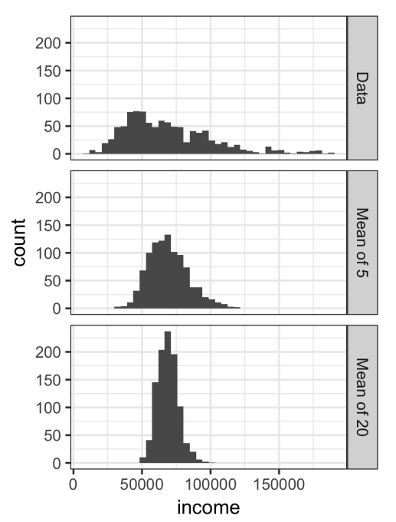
Example: Sampling Distribution of a Statistic
An example using annual income for loan applicants to Lending Club.
Take three samples from this data:
  a sample of 1,000 values,
  a sample of 1,000 means of 5 values, and
  a sample of 1,000 means of 20 values.
The histogram of the individual data values is broadly spread out and skewed toward higher values, as is to be expected with income data.
The histograms of the means of 5 and 20 are increasingly compact and more bell-shaped.

Slide 27
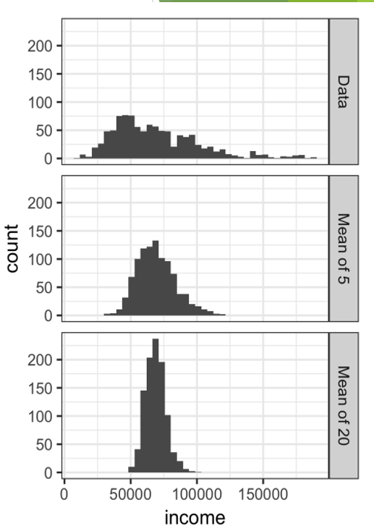
Central Limit Theorem
The phenomenon we’ve just described (in previous slides) is termed the central limit theorem.
The distribution of a mean of sample values is approximately normal, whatever the distribution of the values used to calculate the mean, and grows closer to normal as the sample size increases.
Larger the sample size, more near is the distribution of mean near normal distribution.
It says that the means drawn from multiple samples will resemble the familiar bell-shaped normal curve,
  even if the source population is not normally distributed, provided that the sample size is large enough and
  the departure of the data from normality is not too great.

Slide 28

Standard Error
A statistical term that measures the accuracy with which a sample distribution represents a population by using standard deviation.
In statistics, a sample mean deviates from the actual mean of a population; this deviation is the standard error of the mean.
Standard error represents how well a given sample represents the population. The Standard Error indicates how well the sample mean predicts the real population mean.
The standard error can be estimated using a statistic based on the standard deviation s of the sample values, and the sample size n:
Consider the following approach to measuring standard error:
      Collect a number of brand-new samples from the population.
      For each new sample, calculate the statistic (e.g., median).
      Calculate the standard deviation of the statistics (e.g., median) computed in step 2; use this as your estimate of standard error.
In modern statistics, the bootstrap has become the standard way to estimate standard error.
It can be used for virtually any statistic and does not rely on the central limit theorem or other distributional assumptions.

Slide 29

Standard Error
Calculate the standard error of the given data:
y: 5, 10, 12, 15, 20
Solution: First we have to find the mean of the given data;
  Mean = (5+10+12+15+20)/5 = 62/5 = 10.5
  Now, the standard deviation can be calculated as;
  S = Summation of difference between each value of given data and the mean value/Number of values.
  After solving the above equation, we get;
  S = 5.35
  Therefore, SE can be estimated with the formula;
  SE = S/√n
  SE = 5.35/√5 = 2.39
Think of SE like the “noise” in your estimate.
More samples = less noise = clearer signal (closer to the true population mean).

Slide 30
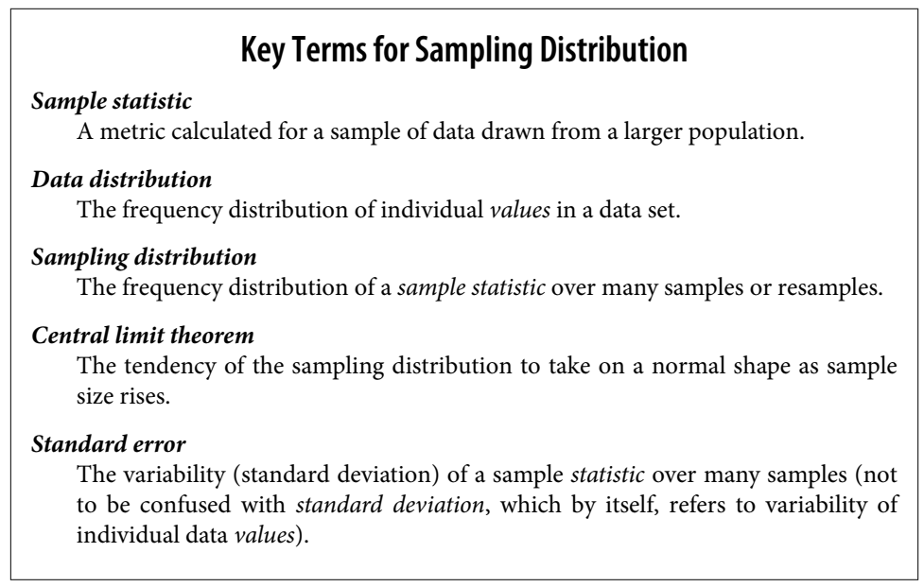
Sampling Distribution

Slide 31
The Bootstrap
Fortunately, it turns out that it is not necessary to draw brand new samples; instead, you can use bootstrap resamples.
One easy and effective way to estimate the sampling distribution of a statistic, or of model parameters is:
  to draw additional samples, with replacement, from the sample itself
  and to recalculate the statistic/fact/metric or model for each resample.
This procedure is called the bootstrap, and it does not necessarily involve any assumptions about the data or the sample statistic/fact being normally distributed.

Slide 32
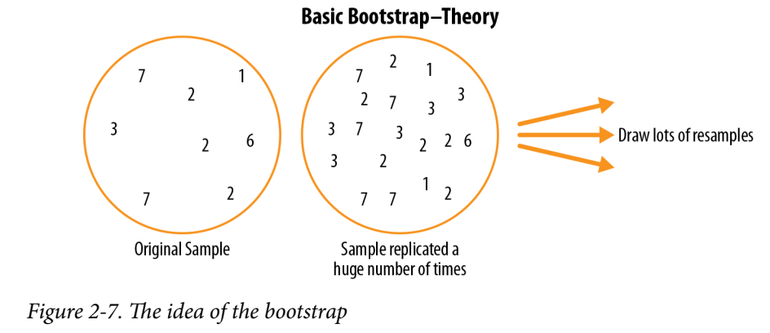
The Bootstrap
Conceptually, you can imagine the bootstrap as replicating the original sample thousands or millions of times so that you have a hypothetical population that embodies all the knowledge from your original sample.
You can then draw samples from this hypothetical population for the purpose of estimating a sampling distribution

Slide 33
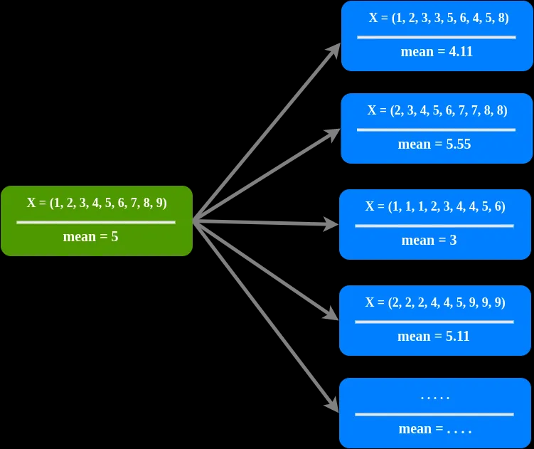
The Bootstrap

Slide 34
The Bootstrap
In practice, it is not necessary to actually replicate the sample a huge number of times.
We simply replace each observation after each draw; that is, we sample with replacement.
In this way we effectively create an infinite population in which the probability of an element being drawn remains unchanged from draw to draw.

Slide 35
The Bootstrap
The algorithm for a bootstrap resampling of the mean, for a sample of size n, is as follows:
    1. Draw a sample value, record it, and then replace it.
    2. Repeat n times.
    3. Record the mean of the n resampled values.
    4. Repeat steps 1–3 R times.
    5. Use the R results to:
      a. Calculate their standard deviation (this estimates sample mean standard error).
      b. Produce a histogram or boxplot.
      c. Find a confidence interval?

Slide 36
The Bootstrap
the number of iterations (R) of the bootstrap, is set somewhat arbitrarily.
The more iterations you do, the more accurate the estimate of the standard error, or the confidence interval.
The result from this procedure is a bootstrap set of sample statistics or estimated model parameters, which you can then examine to see how variable they are.

Slide 37
The Bootstrap
For python example see colab notebook

Slide 38
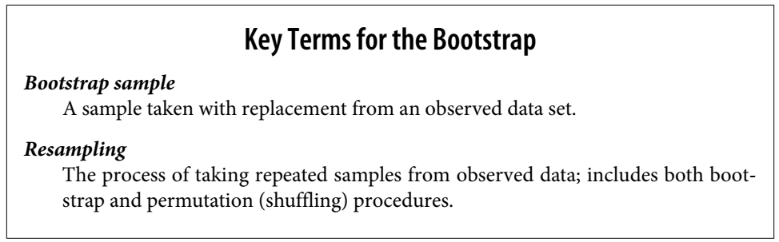

Slide 39
Resampling Versus Bootstrapping
Sometimes the term resampling is used synonymously with the term bootstrapping.
More often, the term resampling also includes permutation procedures where multiple samples are combined and the sampling may be done without replacement.
The term bootstrap always implies sampling with replacement from an observed data set.

Slide 40
Confidence Intervals
A confidence interval shows the probability that a parameter will fall between a pair of values around the mean. Confidence intervals show the degree of uncertainty or certainty in a sampling method.
Confidence intervals always come with a coverage level, expressed as a (high) percentage, say 90% or 95%.
One way to think of a 90% confidence interval is as follows:
  it is the interval that encloses the central 90% of the bootstrap sampling distribution of a sample statistic
Given a sample of size n, and a sample statistic of interest, the algorithm for a boot‐strap confidence interval is as follows:
  1. Draw a random sample of size n with replacement from the data (a resample).
  2. Record the statistic of interest for the resample.
  3. Repeat steps 1–2 many (R) times. Suppose R=10
  4. For a x% confidence interval, trim [(100-x) / 2]% of the R resample results from either end of the distribution.
  5. The trim points are the endpoints of an x% bootstrap confidence interval.

Slide 41
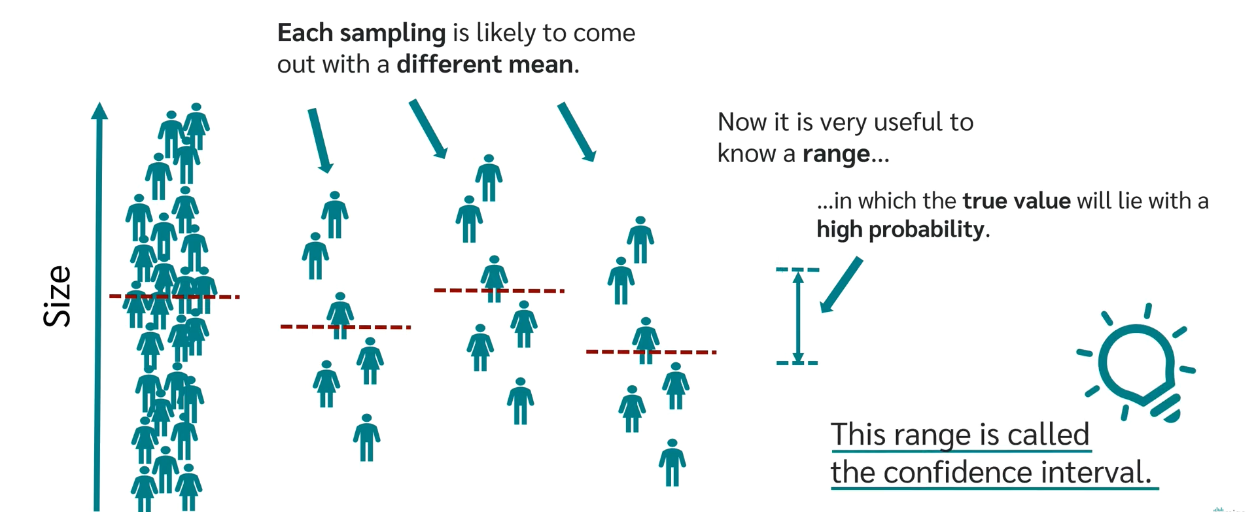
Confidence Intervals

Slide 42
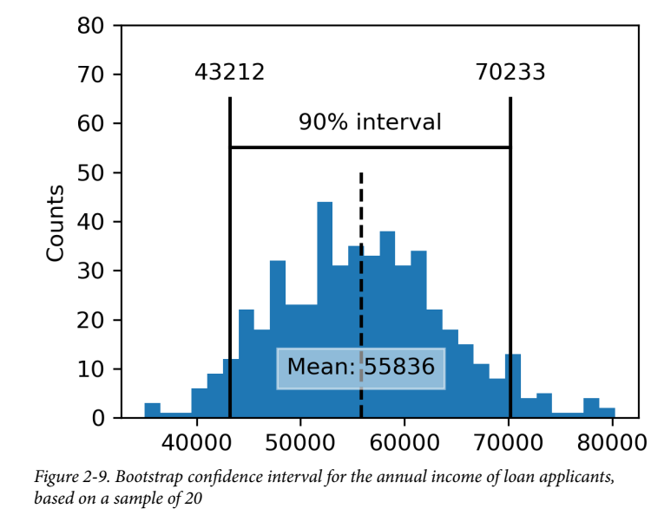
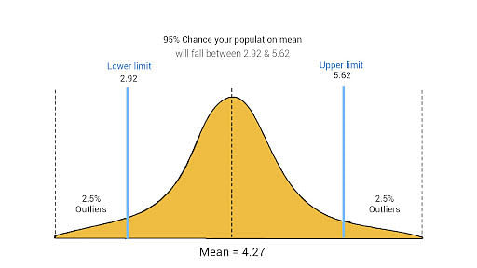
Confidence Intervals
Figure 2-9 shows a 90% confidence interval for the mean annual income of loan applicants, based on a sample of 20 for which the mean was $62,231.
Additional reading
  (Link to CI description with example)

Slide 43
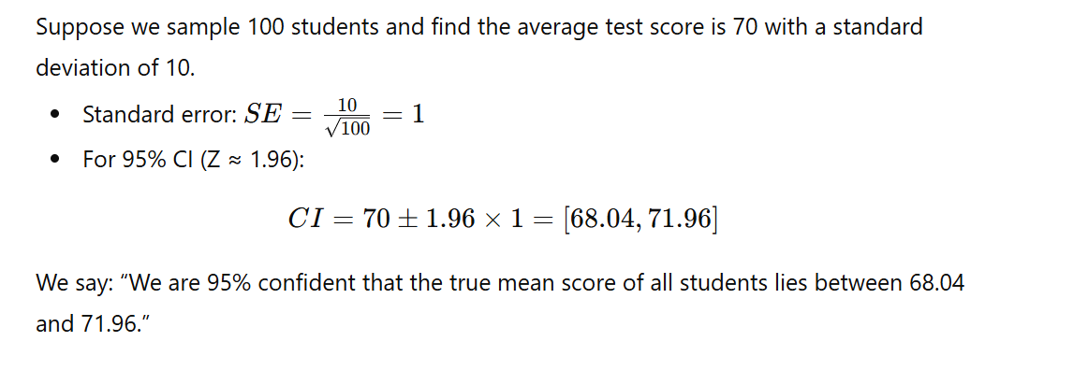
Confidence Intervals: Example

Slide 44
Confidence Intervals (How to calculate CI)
Imagine a group of researchers are interested in determining whether or not the oranges grown on a particular farm are large enough to be sold to a prospective grocery chain.
Step #1: Find the number of samples (n).
  The researchers randomly selected 46 oranges from trees on the farm.
  n = 46.
Step #2: Calculate the mean (x) of the samples.
  Calculated mean weight of 86 grams from their sample.
  x = 86.
Step #3: Calculate the standard deviation (s).
  It’s best to use the SD of the entire population, however, in many cases researchers will not have access to this information. If this is the case, the researchers should use the SD of the sample that they have established.
  For our example, receive a standard deviation of 6.2 grams.
  s = 6.2.
Step #4: Decide the confidence interval that will be used.
  95 percent and 99 percent confidence intervals are the most common choices in typical market research studies.
  In our example, a confidence interval of 95 percent is used.

Slide 45
Confidence Intervals (How to calculate CI)
Step #5: Find the Z value for the selected confidence interval.
  Utilize the following table to determine their Z value:
  Confidence Interval Z
    80% 1.282
    85% 1.440
    90% 1.645
    95% 1.960
    99% 2.576
    99.5% 2.807
    99.9% 3.291
  For 95 percent confidence interval, Z = 1.960.
Step #6: Calculate the following formula.
  Next, plug their known values into the formula.
  Continuing with our example, this formula would appear as follows:
  86 ± 1.960 (6.2/6.782)
  When calculated, this formula gives the researchers the result of 86 ± 1.79 as their confidence interval.
Step #7: Draw a conclusion.
  The researchers have now determined that the true mean of the greater population of oranges is likely (with 95 percent confidence) between 84.21 grams and 87.79 grams.

Slide 46
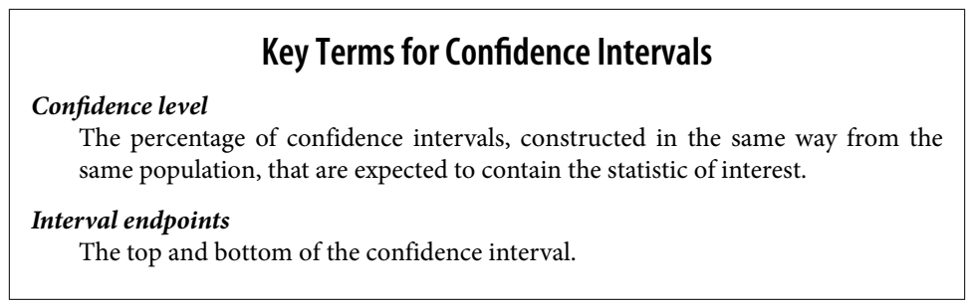
Confidence Intervals

Slide 47
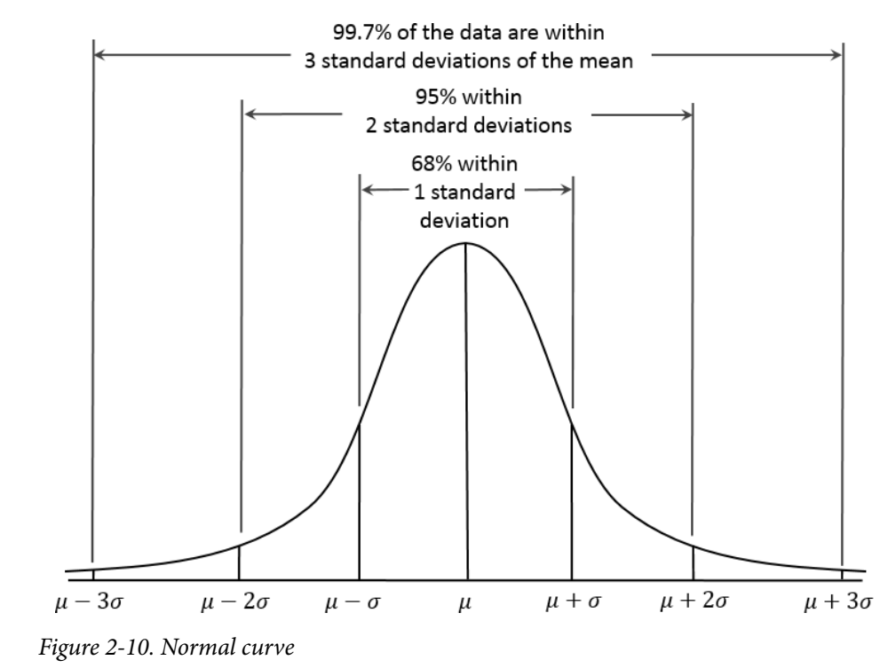
Normal Distribution
The bell-shaped, normal distribution is an iconic in traditional statistics.
The fact that distributions of sample statistics are often normally shaped has made it a powerful tool in the development of mathematical formulas that approximate those distributions.
In a normal distribution,
  68% of the data lies within one standard deviation of the mean, and
  95% lies within two standard deviations.
The normal distribution is also referred to as a Gaussian distribution after Carl Friedrich Gauss.

Slide 48
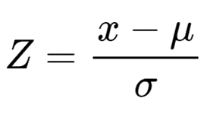
Standard Normal Distribution
A standard normal distribution is one in which the units on the x-axis are expressed in terms of standard deviations away from the mean.
To compare data to a standard normal distribution, you subtract the mean and then divide by the standard deviation; this is also called normalization or standardization.
  E.g data is 5,10,15, its mean is 10
  Subtract mean: -5,0,5, its std dev is 5
  Divide by std Dev: -1,0,1
The transformed value is termed a z-score, and the normal distribution is sometimes called the z-distribution.

Slide 49
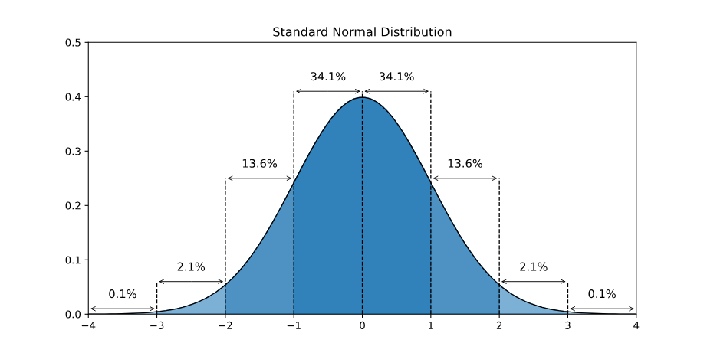
Standard Normal Distribution (additional reading)
Normally distributed data can be transformed into a standard normal distribution.
Standardizing normally distributed data makes it easier to compare different sets of data.
The standard normal distribution is used for:
  Calculating confidence intervals
  Hypothesis tests
Here is a graph of the standard normal distribution with probability values (p-values) between the standard deviations:

Slide 50
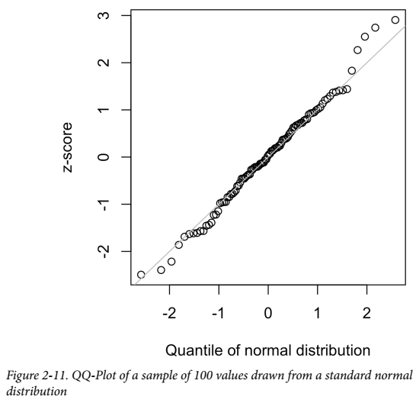
QQ-Plots
A QQ-Plot is used to visually determine how close a sample is to a specified distribution, here it is, the normal distribution.
The QQ-Plot orders the z-scores from low to high and plots each value’s z-score on the y-axis;
  the x-axis is the corresponding quantile of a normal distribution for that value’s rank. (Quantiles are lines that divide the data into equal sized groups and percentiles are just quantiles that divides up the data into 100 equally sized groups)
Since the data is normalized, the units correspond to the number of standard deviations away from the mean.
If the points roughly fall on the diagonal line, then the sample distribution can be considered close to normal.
Figure shows a QQ-Plot for a sample of 100 values randomly generated from a normal distribution; as expected, the points closely follow the line.
Best example of QQ plots (https://www.statisticshowto.com/q-q-plots/)
Another youtube video with example (https://www.youtube.com/watch?v=okjYjClSjOg)

Slide 51
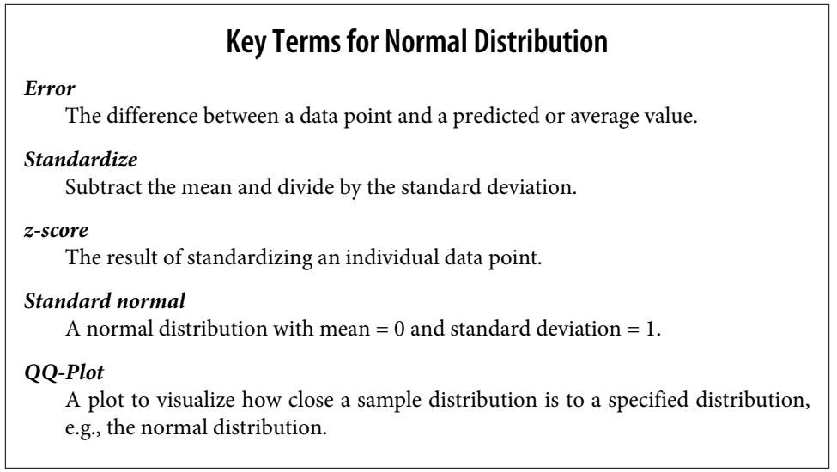
Normal Distribution

Slide 52
Standard Normal and QQ-Plots
For python code please visit notebook for this chapter.

Slide 53
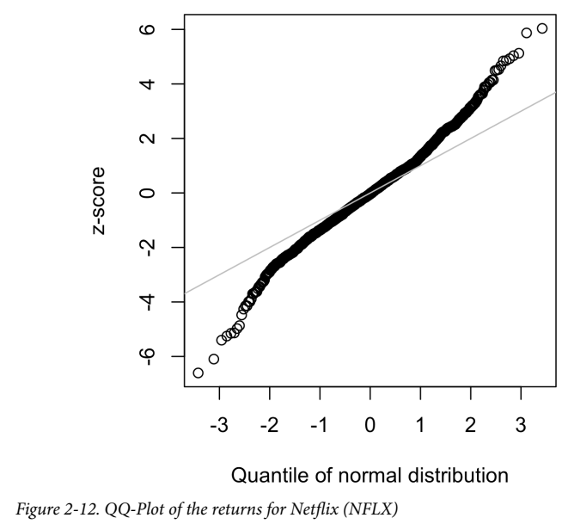
Long-Tailed Distributions
Sometimes, the distribution is highly skewed (asymmetric), such as with income data; or the distribution can be discrete, as with binomial data.
Both symmetric and asymmetric distributions may have long tails.
The tails of a distribution correspond to the extreme values (small and large).

Slide 54
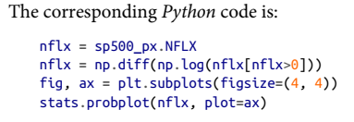
Long-Tailed Distributions
Figure 2-12 shows the QQ-Plot for the daily stock returns for Netflix (NFLX).
the points are far below the line for low values and far above the line for high values, indicating the data are not normally distributed.
This means that we are much more likely to observe extreme values than would be expected if the data had a normal distribution.

Slide 55
Long-Tailed Distributions
Figure 2-12 also shows, the points are close to the line for the data within one standard deviation of the mean.
this phenomenon is referred as data being “normal in the middle” but having much longer tails.

Slide 56

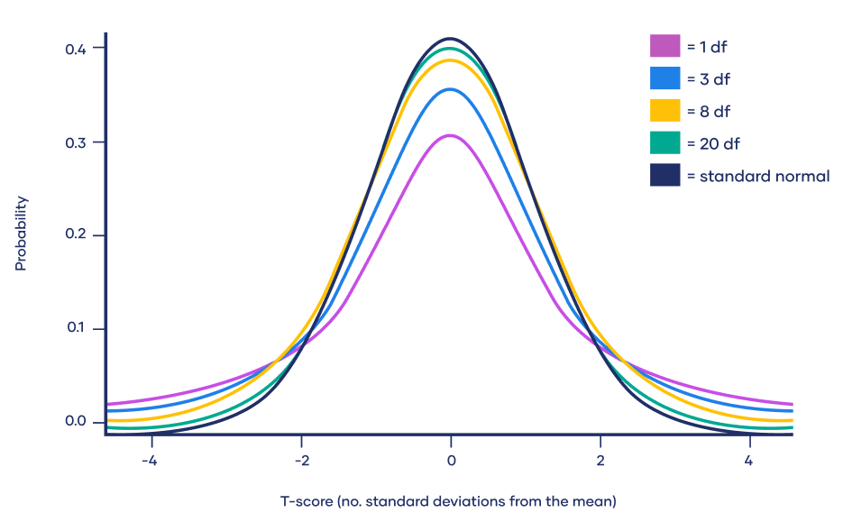
t-Distribution
The t-distribution is a normally shaped distribution, except that it is a bit thicker and longer on the tails.
It is used extensively in depicting distributions of sample statistics.
Distributions of sample means are typically shaped like a t-distribution, and there is a family of t-distributions that differ depending on how large the sample is.
The larger the sample, the more normally shaped the t-distribution becomes.
Consider a sample of size n for which the sample mean x-bar has been calculated. If s is the sample standard deviation, a 90% confidence interval around the sample mean is given by:
where t_{n − 1}(0. 05) is the value of the t-statistic, with [(n – 1) or (R-1)(C-1)] degrees of freedom
that “chops off ” 5% of the t-distribution at either end.

Slide 57
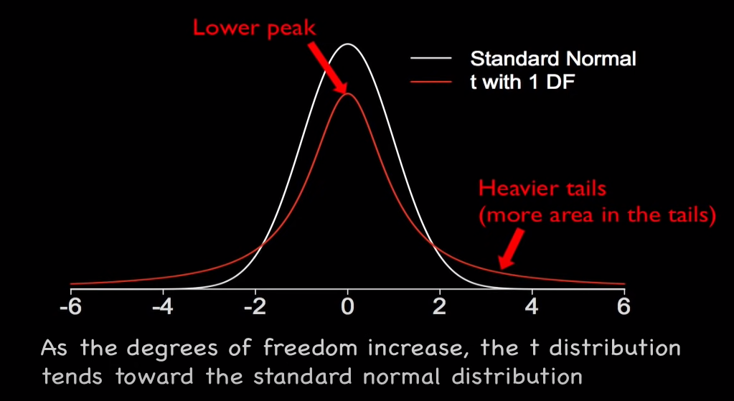
t-Distribution

Slide 58
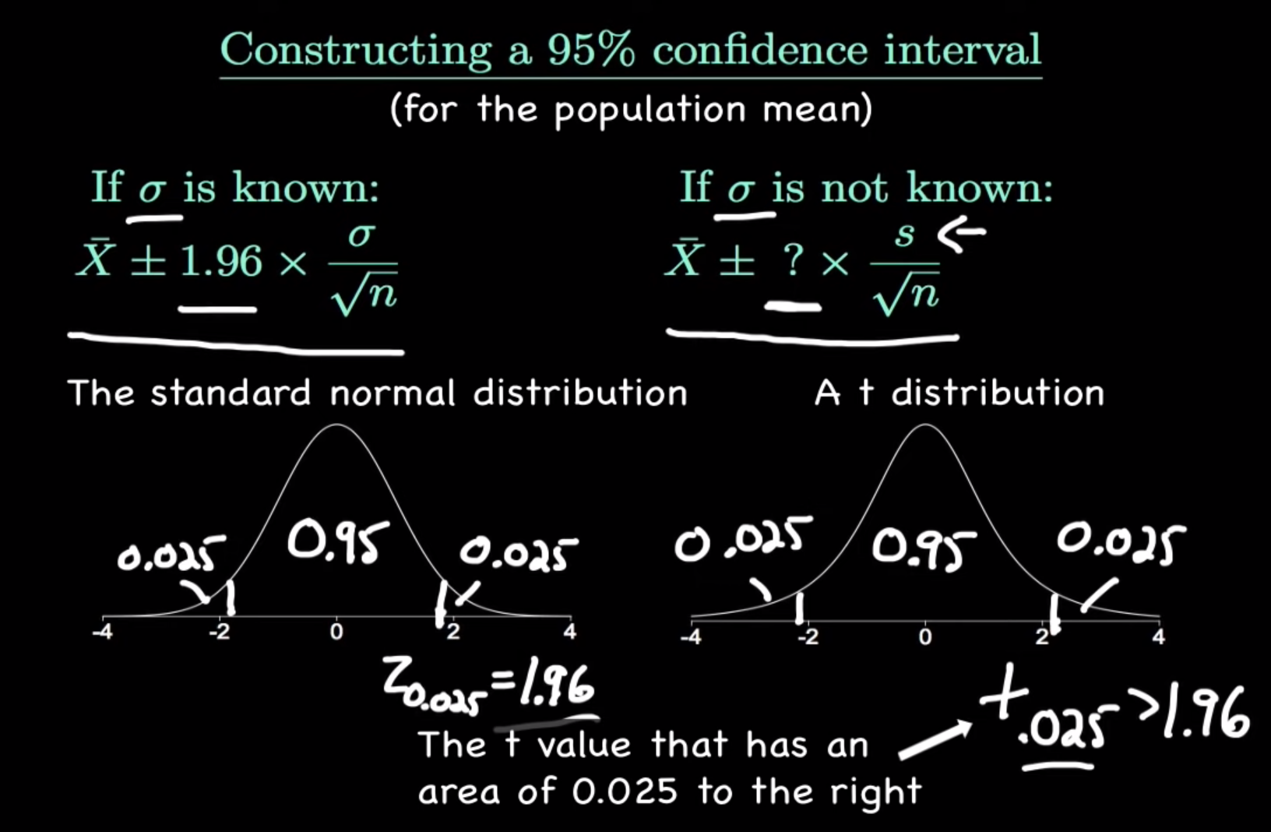
t-Distribution
For standard normal distribution we can find 95% confidence interval z score from z score table.
However, for t-distributed data the tail of distribution can have different locations due to different DoF. Therefore, we find t value w.r.t to DoF for finding CI.

Slide 59
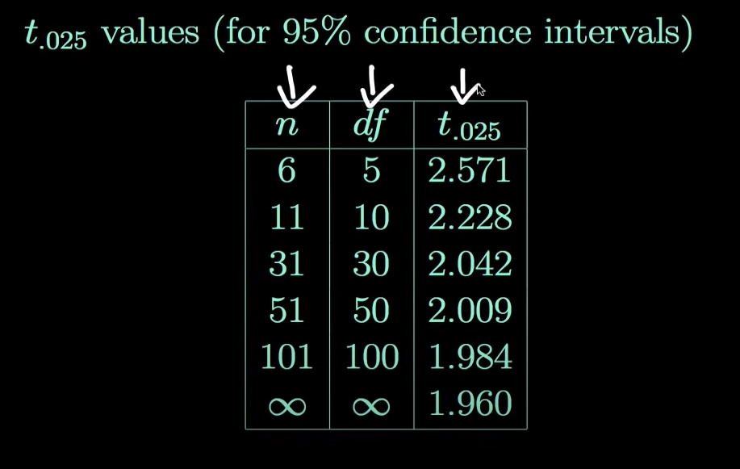
t-Distribution
T-table https://www.w3schools.com/statistics/statistics_t_table.php
https://www.youtube.com/watch?v=Uv6nGIgZMVw

Slide 60
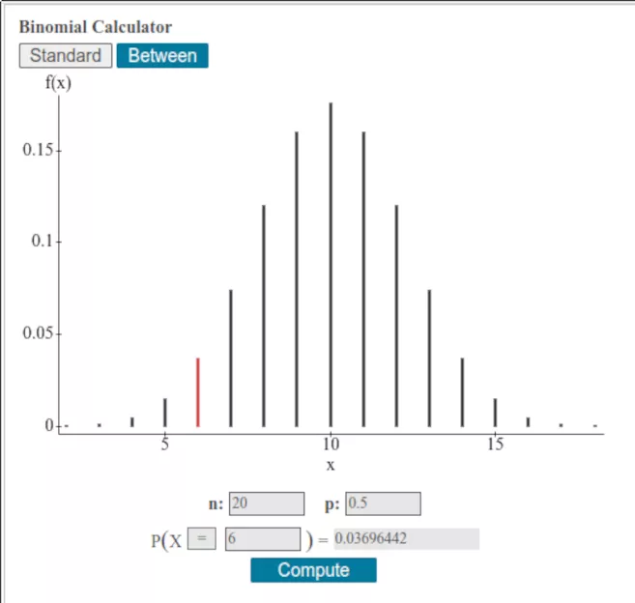
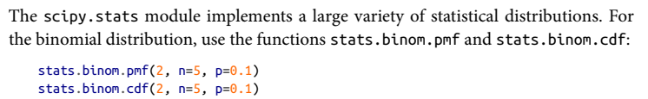
Binomial Distribution
Binomial Distribution is a Discrete Distribution.
It describes the outcome of binary scenarios(toss of a coin, it will either be head or tails.
It has three parameters:
  n - number of trials.
  p - probability of occurrence of each trial (e.g. for toss of a coin 0.5 each).
  size - The shape of the returned array.
The binomial distribution is the idea of a set of trials, each trial having two possible outcomes(yes/no, buy/NotBuy, 1/0) with definite probabilities.
For example, flipping a coin 10 times is a binomial experiment with 10 trials, each trial having two possible outcomes (heads or tails).
The binomial distribution is the frequency distribution of the number of successes (x) in a given number of trials (n) with specified probability (p) of success in each trial.
would return 0.0729, the probability of observing exactly x = 2 successes in size = 5 trials, where the probability of success for each trial is p = 0.1

Slide 61
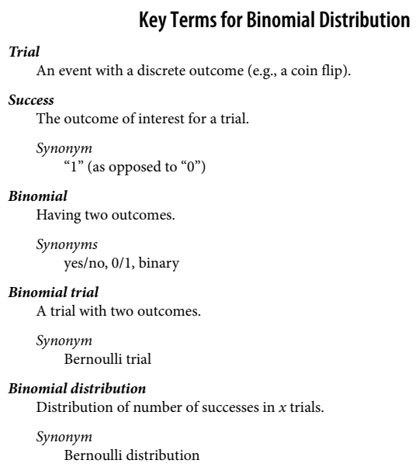
Binomial Distribution
There is a family of binomial distributions, depending on the values of n and p.
The binomial distribution would answer a question like:
  If the probability of a click converting to a sale is 0.02, what is the probability of observing 0 sales in 200 clicks?
    X=0, n=200, p=0.02
    stats.binom.pmf(0, n=200, p=0.02)
    Ans: 0.017587946605721567

Slide 62
Chi-Square Distribution
Chi-square (Χ2) distributions are a family of continuous probability distributions. They’re widely used in hypothesis tests, including the chi-square goodness of fit test and the chi-square test of independence.
The shape of a chi-square distribution is determined by the parameter k, which represents the degrees of freedom.
Very few real-world observations follow a chi-square distribution. The main purpose of chi-square distributions is hypothesis testing, not describing real-world distributions.
Chi-square distributions are useful for hypothesis testing because of their close relationship to the standard normal distribution.

Slide 63



Chi-Square Distribution
Imagine taking a random sample of a standard normal distribution (Z). If you squared all the values in the sample, you would have the chi-square distribution with k = 1.
  Χ²₁ = (Z)²
Now imagine taking samples from two standard normal distributions (Z1 and Z2). If each time you sampled a pair of values, you squared them and added them together, you would have the chi-square distribution with k = 2.
  Χ22 = (Z1)2 + (Z2)2
More generally, if you sample from k independent standard normal distributions and then square and sum the values, you’ll produce a chi-square distribution with k degrees of freedom.
Χ2k = (Z1)2 + (Z2)2 + … + (Zk)2

Slide 64

Poisson and Related Distributions
The Poisson distribution tells us the distribution of events per unit of time or space when we sample many such units.
  From prior aggregate data (for example, number of flu infections per year), we can estimate the average number of events per unit of time or space (e.g., infections per day, or per census unit).
The key parameter in a Poisson distribution is λ, or lambda. This is the mean number of events that occurs in a specified interval of time or space.
The variance for a Poisson distribution is also λ.

Slide 65
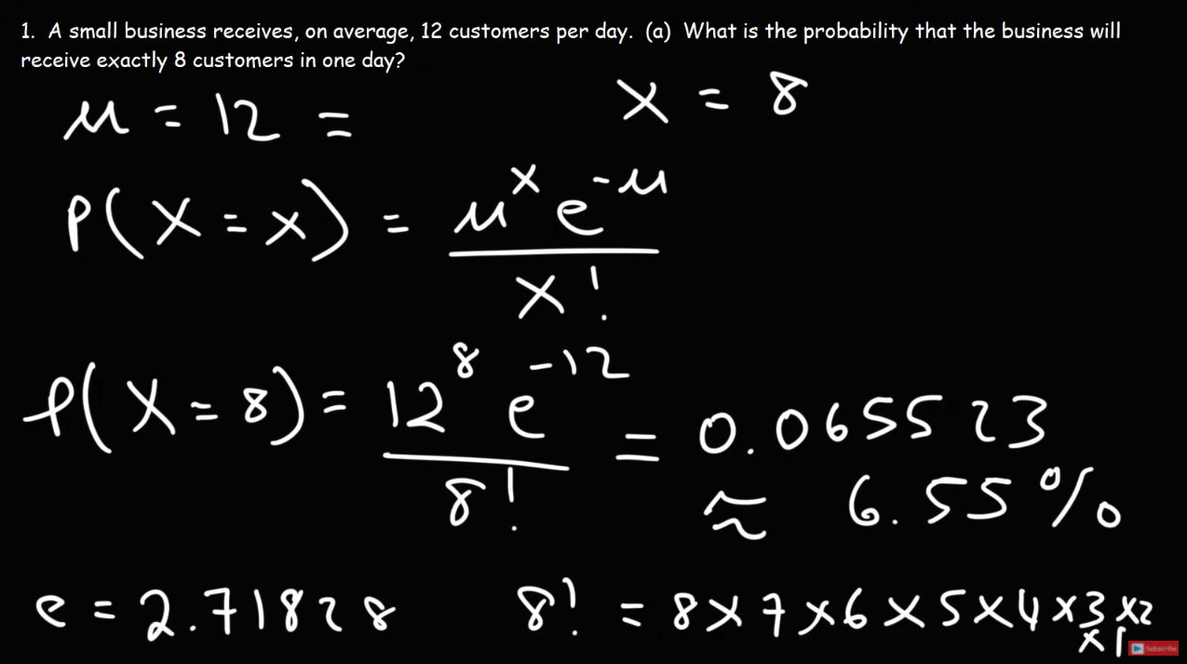
Poisson and Related Distributions

Slide 66
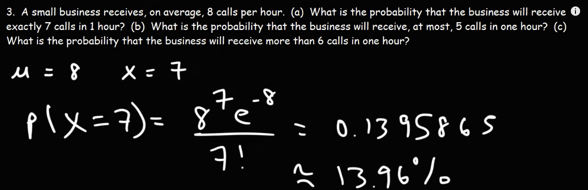

Slide 67
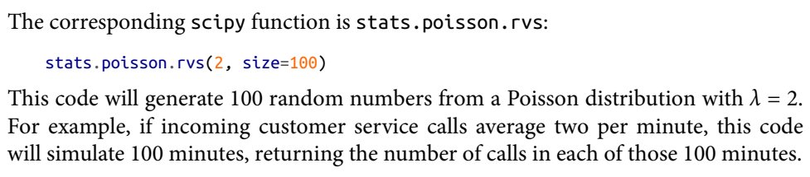
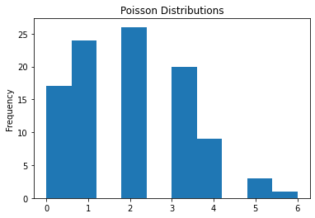
Poisson and Related Distributions
17 calls at zero min
24 calls at 1 min

Slide 68
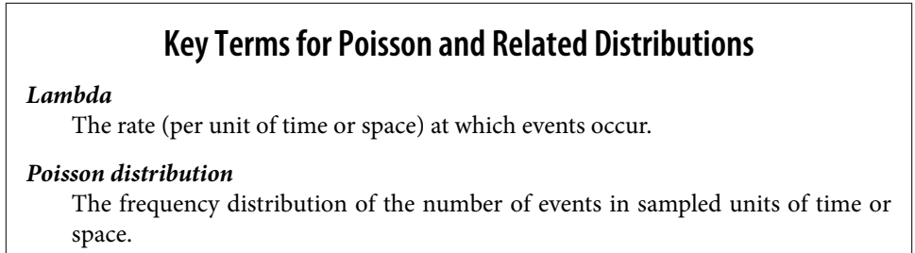
Poisson and Related Distributions

